Slide 1
Impact of Income on Student Achievement
By Ron Maxseiner, Sadam Assen & Akhilesh Keerthi

Slide 2
Agenda
Problem Statement
Tools and Technology
Analysis Methods Used
Results
Primary Component Analysis (PCA)
K Means
Linear Regression
Decision Tree
Conclusions

Slide 3
Problem Statement
Does the Income earned by residents of a county impact the academic achievement of the students of a county?
Data Sets
SchoolDigger
Summary of available data sets from the Virginia Department of Education
Standard score is an averaged result of all the Standards of Learning (SOL) from the school year for that school
School data such as number of students, student/teacher ratio and percent free lunch
Race data for school is provided along with School Attributes such as Title I, Charter, Magnet, and Virtual
Results per school but summarized to School District or County level
County School and Income
Provided Income for County along with Expenditures per pupil

Slide 4
Tools and Technology Used
Initially Weka was used to explore and understand the data sets. Once the data was better understood, excel was used to view and modify the data.
Preprocessing and Visualizations - Python, pandas and numpy packages.
Linear Regression and Clustering - R with caret, ggcorplot, ggplot2, dpylr and glmnet.
Decision Tree and Exploratory Data Analysis was completed in SAS JMP
Visualizations - SAS JMP and ggcorplot and ggplot

Slide 5
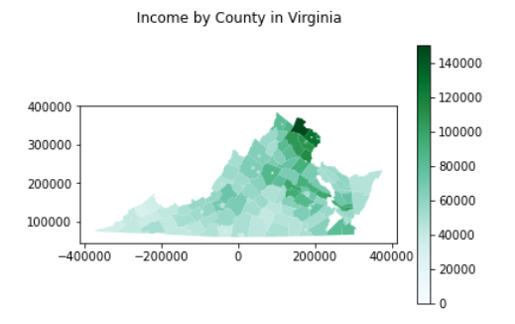
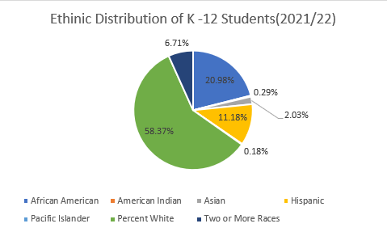
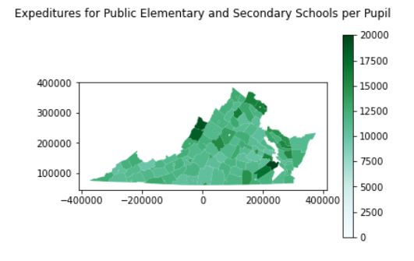
Exploratory Data Analysis
Even at during EDA the data provided many interesting insights.

Slide 6
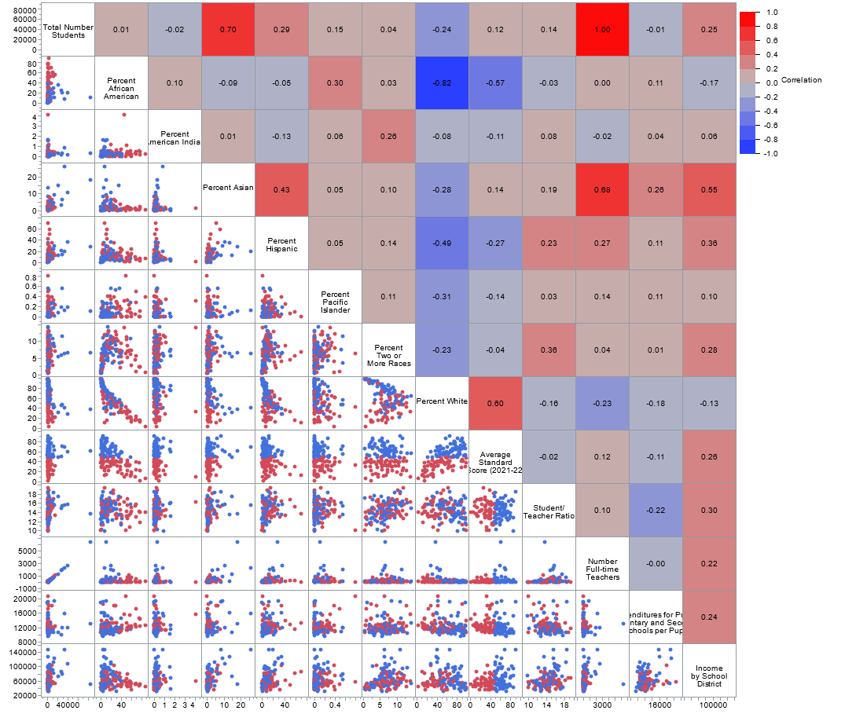
Correlation Plot Matrix

Slide 7
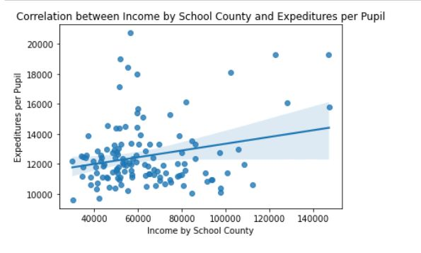
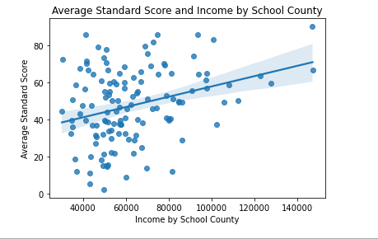

Slide 8
Analysis Methods
We used the following techniques to analyze the data
Primary Component Analysis (PCA) to identify possible cross correlation and possible dimension reduction.
Clustering - Determine if clusters of other variables appeared with relation to Income
Linear Regression - Understand the relationship between Income and Academic Achievement.
Decision Trees - Another way to understand the relationship between Income and Academic Achievement.

Slide 9
Results - PCA
PCA analysis revealed that the first two components explain a majority of the variance.
11 components explain 100%.
This means there were two that could be easily dropped but others would lose information.
 | Standard deviation | Proportion of Variance | Cumulative Proportion
Comp.1 | 0.9173 | 0.5168 | 0.5168
Comp.2 | 0.5468 | 0.1836 | 0.7004
Comp.3 | 0.3534 | 0.0767 | 0.7771
Comp.4 | 0.3379 | 0.0701 | 0.8473
Comp.5 | 0.2924 | 0.0525 | 0.8998
Comp.6 | 0.2455 | 0.0370 | 0.9368
Comp.7 | 0.2279 | 0.0319 | 0.9687
Comp.8 | 0.1649 | 0.0167 | 0.9854
Comp.9 | 0.1098 | 0.0074 | 0.9928
Comp.10 | 0.0920 | 0.0052 | 0.9980
Comp.11 | 0.0571 | 0.0020 | 1.0000
Comp.12 | 0.0009 | 0.0000 | 1.0000
Comp.13 | 0.0000 | 0.0000 | 1.0000

Slide 10
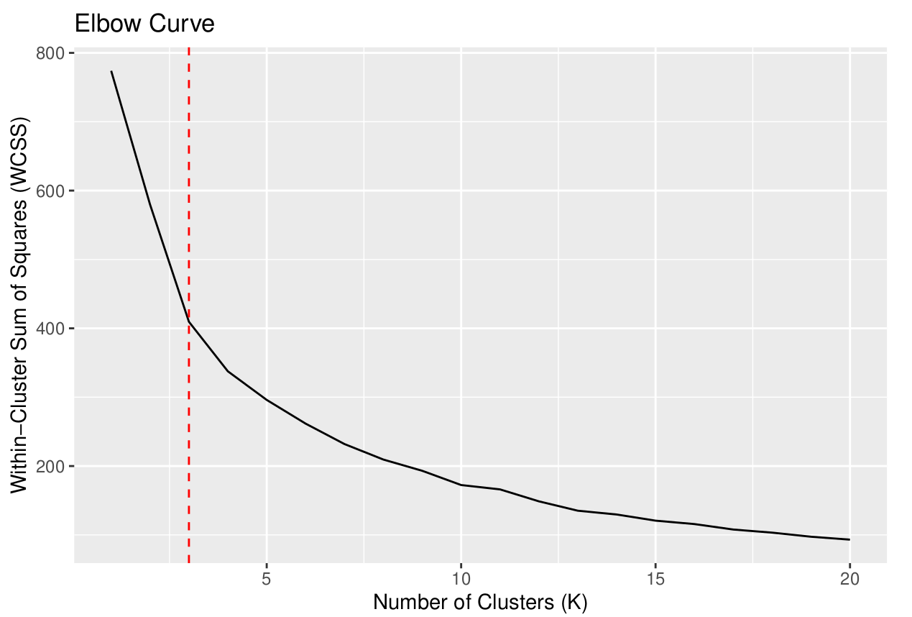
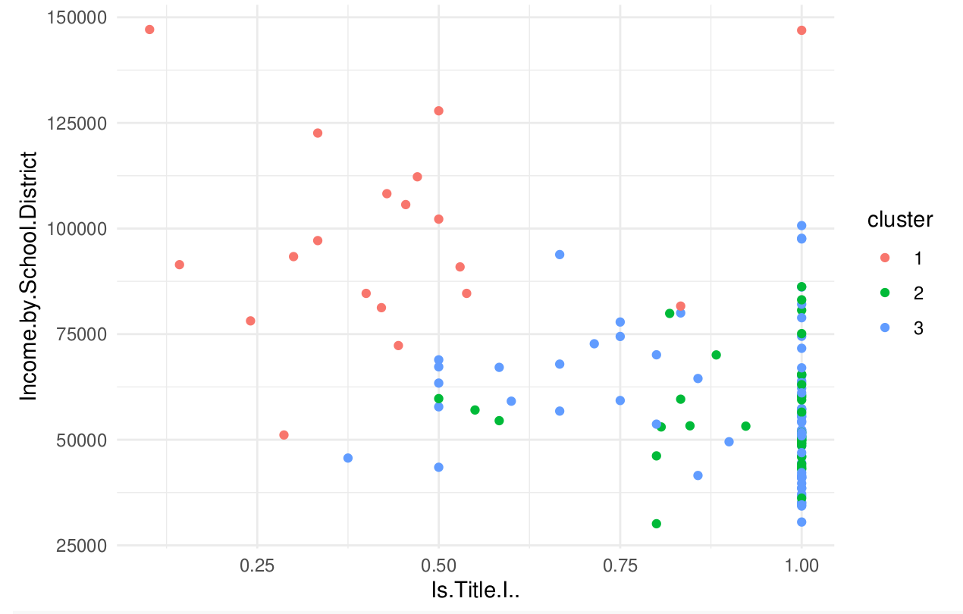
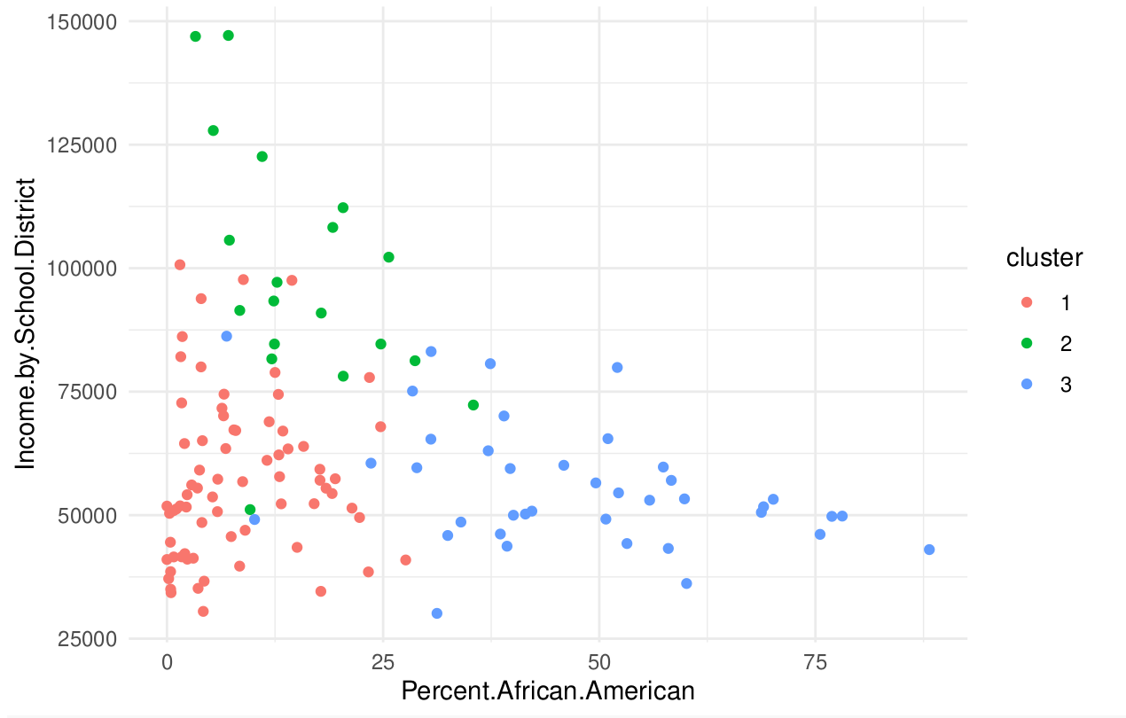
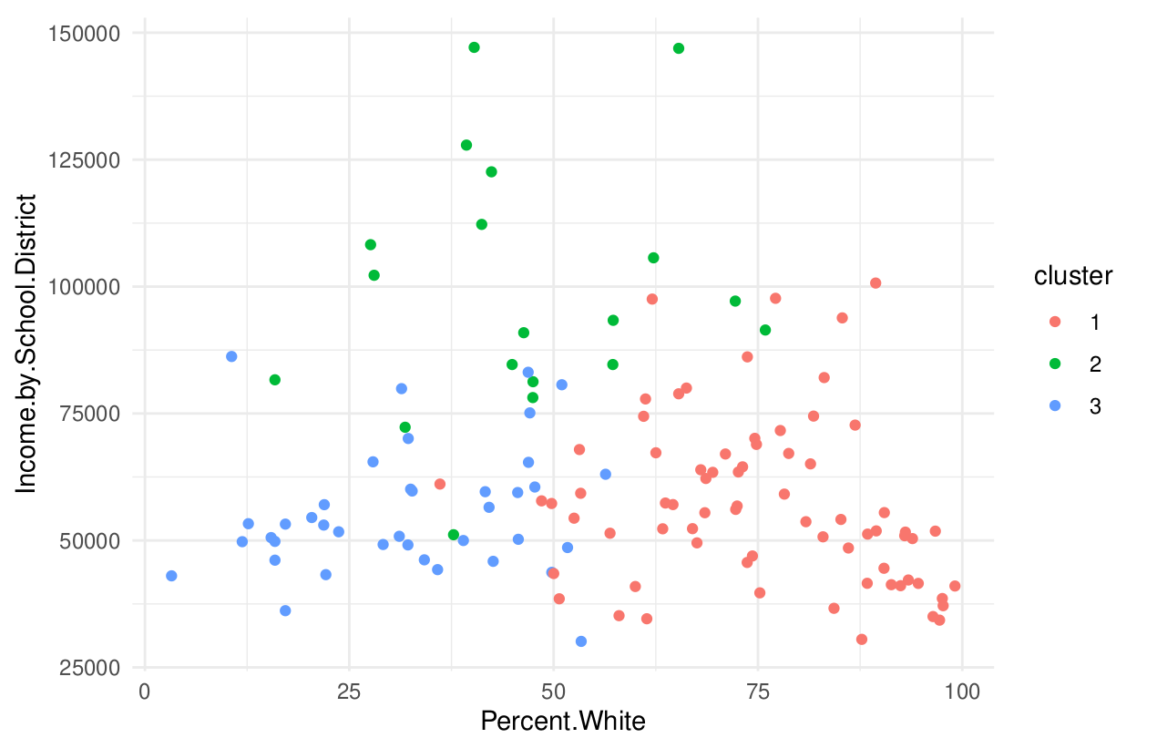
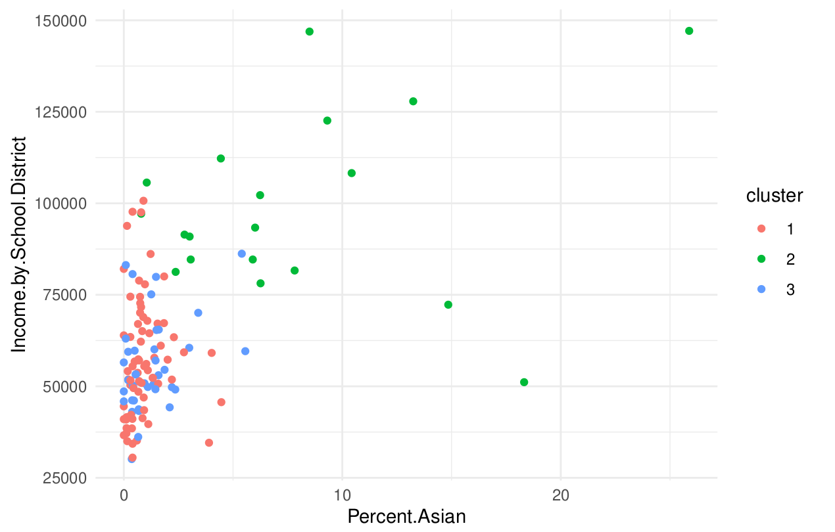
Results - Clustering
K Means clustering was used to determine the the optimum clusters was 3
Clusters were not clearly defined when viewed from with respect to Income
Further Analysis was not performed.

Slide 11
Results - Linear Regression
Linear Regression show two statistically significant variables, Income by School District and Percent White.
Notice Expenditures are not statistically significant.
Relationships between Expenditures and Income is statistically significant but only with R = 0.05
Other less statistically significant variables are Percent African American, Percent Asian, and Is Title I
Variable | Estimate | Std. Error | t value | Pr(>|t|)
(Intercept) | 7.216 | 20.72 | 0.348 | 0.7283
Expenditures.per.Pupil | -0.0011 | 0.0007 | -1.621 | 0.1078
Income.by.School.District | 0.0003 | 0.0001 | 3.47 | 0.0007 | ***
Total.Number.Students | -0.0011 | 0.0022 | -0.496 | 0.6208
Percent.White | 0.7808 | 0.1157 | 6.746 | 0.000 | ***
Percent.African.American | 0.3175 | 0.1331 | 2.387 | 0.0186 | *
Percent.American.Indian | -2.997 | 2.74 | -1.094 | 0.2763
Percent.Asian | 1.207 | 0.688 | 1.754 | 0.0821 | .
Percent.Pacific.Islander | 0.5071 | 9.204 | 0.055 | 0.9562
Number.Full.time.Teachers | 0.0168 | 0.0302 | 0.555 | 0.5799
Student.Teacher.Ratio | -0.338 | 0.7809 | -0.433 | 0.666
Is.Title.I.. | -13.36 | 7.165 | -1.865 | 0.0647 | .
Is.Charter.. | -305.2 | 300.2 | -1.016 | 0.3116
Is.Magnet.. | 10.98 | 15.82 | 0.694 | 0.4889
Is.Virtual.. | NA | NA | NA | NA

Slide 12
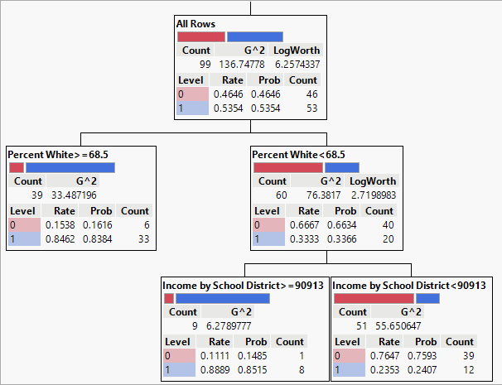
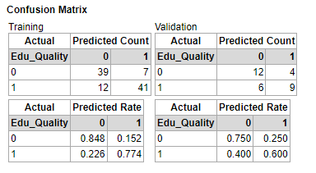
Results - Decision Tree
Above average Standard Score was considered a positive outcome.
Used all 13 predictor variables.
Results showed entropy was reduced most by using Percent White than Income by School district.

Slide 13
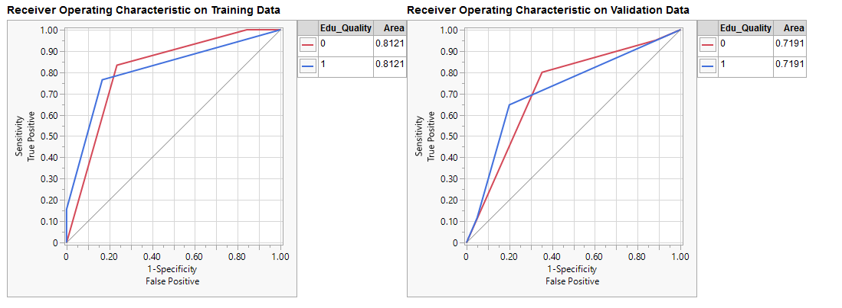
ROC Curve of Decision Tree

Slide 14
Conclusions and Future Work
Conclusions
Income is related to academic achievement but not in the way we expected.
Income is related to Expenditures per Pupil but only accounts for 5%
Impact of Race on academic achievement was clear but not the focus of our investigation
Results were surprising even though analytical techniques were not complex.
Future Work
There are many interesting questions regarding this topic that we believe could be pursued
Does the education background of parents have an effect on student achievement?
What about marital status? Do students raised by a single parent have a lower education achievement compared to students raised by two parents?

Slide 15
Thank you

